Slide 1
Ecommerce Website Conversion Analysis
18th February 2023
Yogita Mane

Slide 2
Website Conversion Analysis
Demonstrate Effectiveness of the media campaigns - Analyzing impressions, clicks, media cost, and conversion rate to identify best-performing campaigns & areas needing improvement.
Analyse the correlation between website traffic, website conversions, and total revenue - Identify website effectiveness in driving sales; assess design, user experience, and marketing strategies to improve.
Key Business considerations
Use the conversion rate data - Identify best-performing weeks and analyse contributing factors to help replicate successful strategies.
Use the data to forecast the media cost required to generate a particular revenue target, such as $10 million - Analyze media cost-website conversions-total revenue relationship to identify conversion rate to reach revenue target.

Slide 3
Business Question
"Demonstrate prediction on number of Impressions, Clicks, and Media cost is required to achieve a revenue target of $10 million for our business"

Slide 4












Data Pipeline
DATA COLLECTION
DATA TRANSFORMATION
DATA VISUALIZATION
DATA CLEANING AND PREPROCESSING
DATA ANALYSIS
REPORTING AND COMMUNICATION

Slide 5
Data Overview
DATA PARAMETERS
MARKET
DATA FEATURES
Week commencing
Dataset covers a period of 33 weeks, from 27-Jun-22 to 6-Feb-23
Categorical features:
Impressions
Week commencing (date)
Continuous numerical features:
Impressions (number of times an ad is displayed)
Clicks (number of times an ad is clicked)
Media cost (cost of running the ad campaign)
Website Traffic (number of visits to the website)
Website Conversions (number of successful conversions on the website)
Total Revenue (revenue generated from the website)
Ratio features:
Conversion rate (ratio of the number of successful conversions to the number of website visits)
Derived features:
Revenue per click (RPC) = Total Revenue / Clicks
Website conversion rate (WCR) = Website Conversions / Website Traffic
Clicks
Media cost
Website Traffic
Website Conversions
Total Revenue
Conversion rate

Slide 6
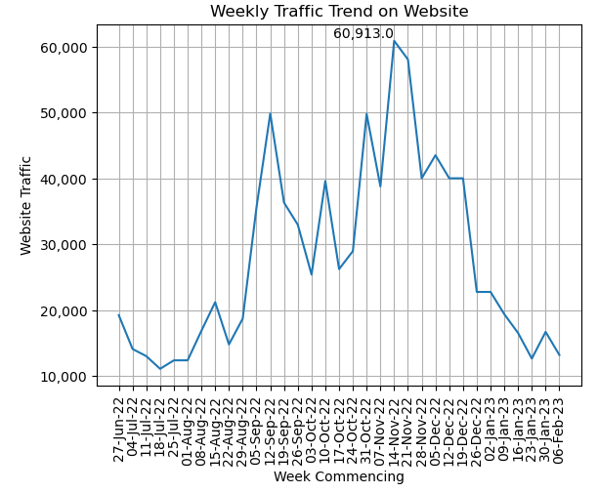
Explanatory Data Analysis
Website Traffic Trend
Website traffic peaks and dips at certain months, increasing towards the end of year and decreasing at the start.
This seasonal pattern could be driven by a number of factors, such as holiday shopping, changes in consumer behavior or preferences, or weather patterns.
Website traffic is trending up, suggesting increased visibility/popularity, but there are weekly fluctuations and inconsistency.
Increased traffic can boost potential revenue/conversions, yet actual conversion rate (percentage of visitors who take desired action e.g. purchase) varies.

Slide 7
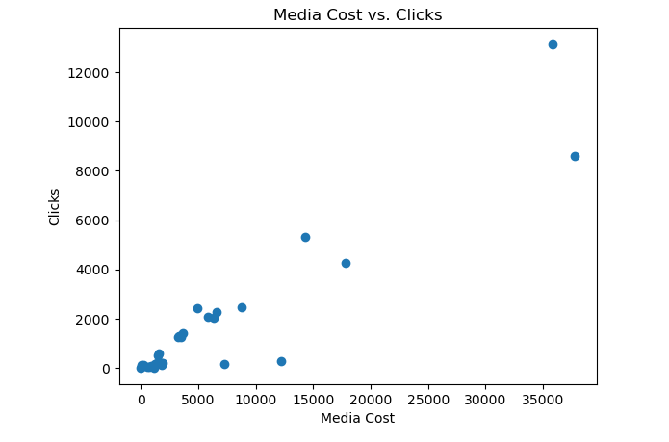
Explanatory Data Analysis
Correlation between media cost and the number of clicks
As media cost increases, click rate also increases, suggesting a positive correlation.
This could be a result of a number of factors, such as more visibility for the website due to increased ad spend, better ad targeting leading to more clicks, or a combination of both.

Slide 8
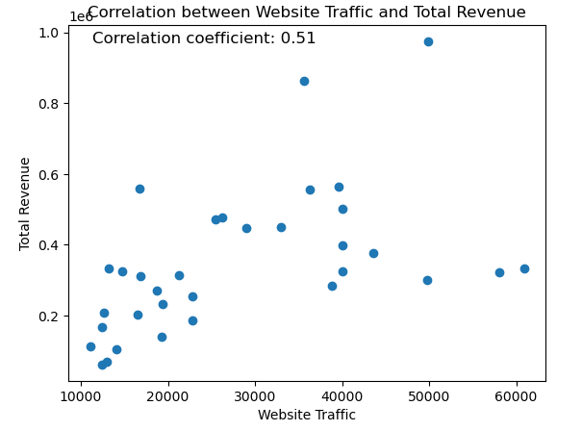
Explanatory Data Analysis
Correlation coefficient between website traffic and total revenue
A 0.5118 correlation coefficient between website traffic and total revenue indicates a positive, moderate correlation.
A coefficient of 0.5118 indicates a positive correlation between website traffic and total revenue, though not a strong one.
Website traffic and revenue are affected by multiple factors such as traffic quality, user experience, pricing, marketing strategies, etc.

Slide 9
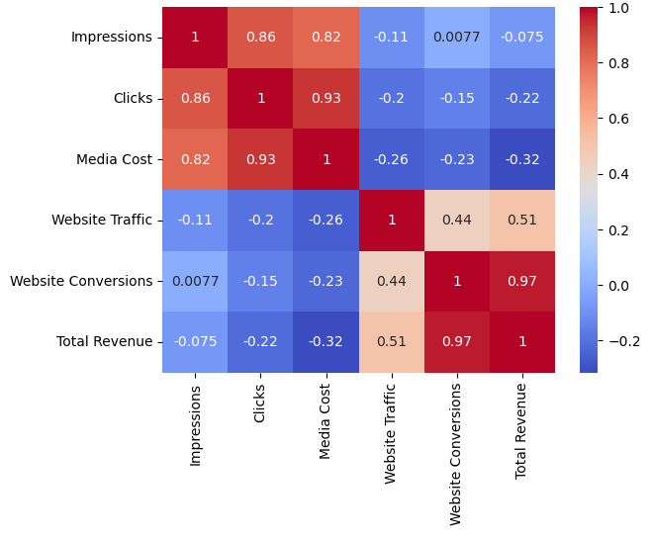
Explanatory Data Analysis
Visual representation of the correlation matrix
Each square denotes correlation between two variables, color representing strength and direction.
Total revenue moderately positively correlates with website traffic and clicks.
There is also a moderate positive correlation between website traffic and the number of clicks.

Slide 10
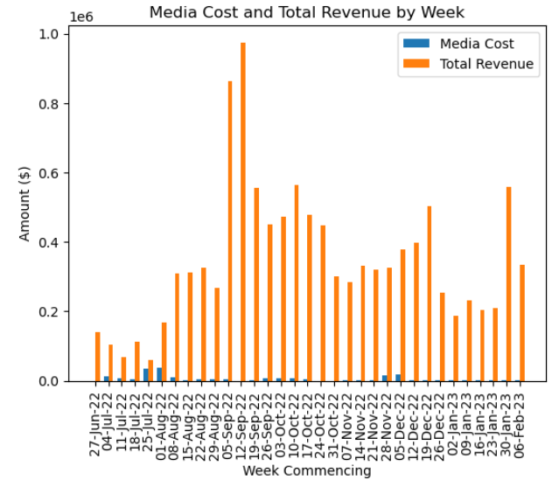
Overview
The orange bar (total revenue) being higher than the blue bar (media cost) on the bar chart shows that the company made higher revenue than media cost, suggesting the advertising strategy was effective.

Slide 11


Explanatory Data Analysis
KEY FINDINGS
- Total Revenue of $11,485,888.74 generated in 33 weeks
- 30-Jan-23 had a 1.62% conversion rate, likely due to marketing promotions, website optimization, and seasonal trends.
- CPC of $3.74 can influence the number of clicks a website gets, which can affect revenue through greater website traffic and sales.
- The week of 25-Jul-22 saw the most impressions of 3,788,966.84. This is much higher than other weeks, from 10 to 1,934,297. Likely caused by additional advertising channels or increased ad spend, or a seasonal event/promotion.

Slide 12
Data Pre-processing and Transformation
DATA PRE-PROCESSING
DATA TRANSFORMATION
New column for the revenue per click (RPC) by dividing the total revenue by the number of clicks.
Removing the dollar sign from the 'Total Revenue' column, percentage sign from the 'Conversion Rate' column, and converting it to a numerical data type.
Checking for any missing or erroneous values in the data
Converts the 'Week commencing' column to datetime format.
New column for the Website Conversion Rate (WCR) by dividing the website conversions by the website traffic.

Slide 13
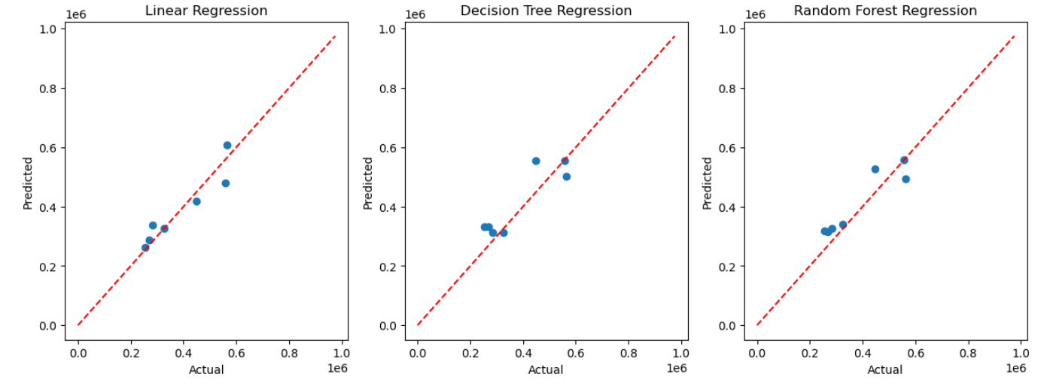
Modeling Comparison
The Linear Regression model displays closely clustered points around the red line, showing its accuracy in predicting revenue. In contrast, the scatter plots of the Decision Tree and Random Forest models are more scattered, suggesting lower accuracy.

Slide 14
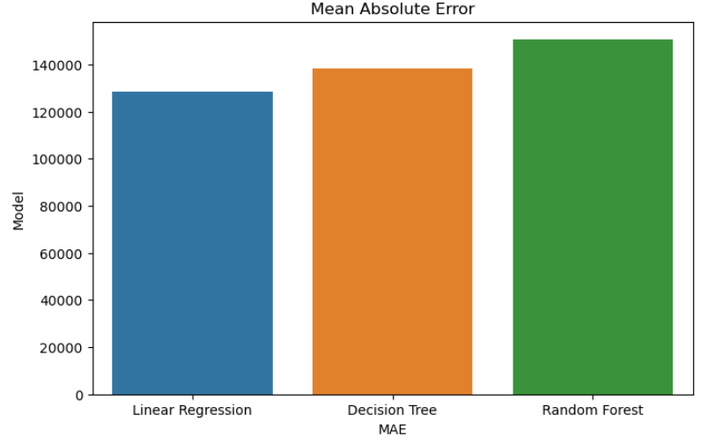
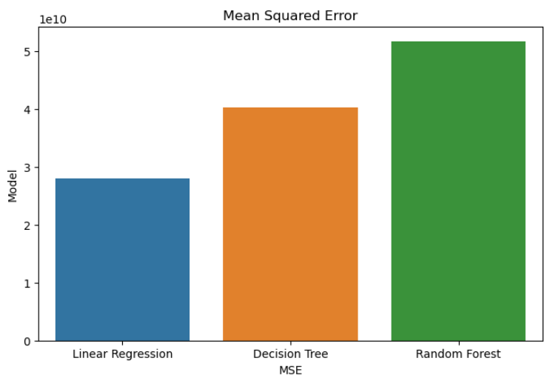
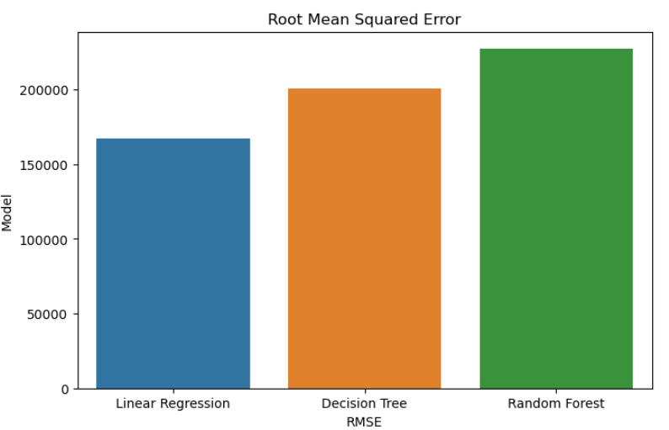
Evaluation Metrics
Linear Regression performs best with lowest MAE, MSE, and RMSE. It can be used for predicting revenue accurately for financial planning and decision-making. Decision Tree Regression performs well, but poorer than Linear Regression. Random Forest Regression has highest values for all three metrics, suggesting poorer performance.
Overall, the evaluation metrics give the business an idea of which models are the most effective, and can be used to guide decision-making and resource allocation.

Slide 15



Summary
Predicted number of impressions, clicks, and media cost for $10 million revenue
PREDICTED IMPRESSIONS
PREDICTED CLICKS
PREDICTED MEDIA COST
251,804
256,576
$236,842

Slide 16

Insights and Recommendations
MEDIA COST, WEBSITE TRAFFIC, IMPRESSIONS, AND CLICKS ARE KEY FACTORS.
THE CONVERSION RATE RANGES FROM 0.26%-1.62%.
INVESTIGATE WAYS TO INCREASE WEBSITE CONVERSION RATE BY IMPROVING USER EXPERIENCE OR OFFERING PROMOTIONS.
INCREASE MEDIA SPEND AND WEBSITE TRAFFIC TO INCREASE IMPRESSIONS AND CLICKS.
INCREASING WEBSITE TRAFFIC AND WEBSITE CONVERSION HAS A POSITIVE EFFECT ON TOTAL REVENUE, WHEREAS THE CONVERSION RATE VARIABLE HAS A NEGATIVE EFFECT, SUGGESTING THAT THE COMPANY SHOULD PRIORITIZE RAISING TRAFFIC AND CONVERSION RATHER THAN SOLELY THE CONVERSION RATE.
LINEAR REGRESSION IS THE BEST MODEL, FOLLOWED BY DECISION TREE; RANDOM FOREST PERFORMED WORST.
MONITOR AND ANALYZE DATA TO IDENTIFY TRENDS/IMPROVEMENT OPPORTUNITIES.
DATA-DRIVEN INSIGHTS ENABLE INFORMED DECISIONS FOR IMPROVED PERFORMANCE AND INCREASED REVENUE.
USE LINEAR OR DECISION TREE REGRESSION MODELS FOR FUTURE PREDICTIONS.

Slide 17
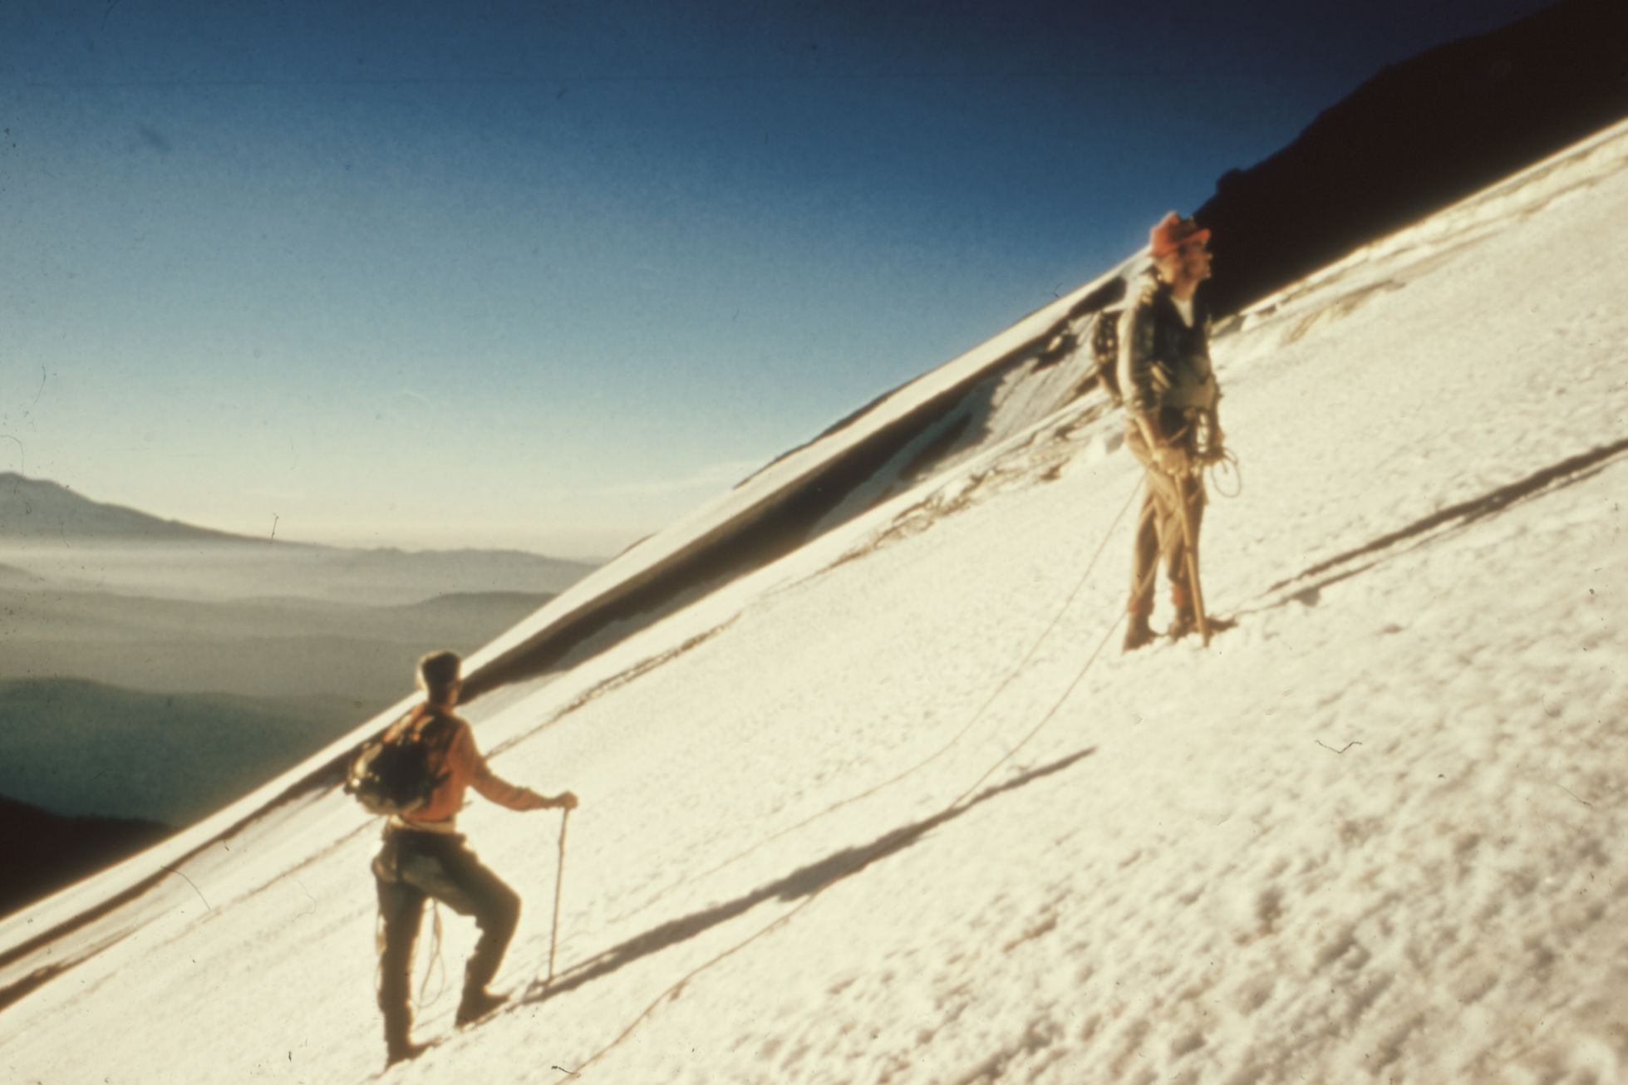


Action Plan
INCREASE INVESTMENT IN DIGITAL MEDIA: INCREASING DIGITAL MEDIA SPEND COULD IMPROVE ONLINE VISIBILITY, ATTRACT MORE CUSTOMERS, AND INCREASE WEBSITE TRAFFIC, CONVERSIONS, AND REVENUE.
OPTIMIZE THE WEBSITE: PERFORMING A/B TESTING AND USER RESEARCH TO IDENTIFY AREAS OF IMPROVEMENT CAN LEAD TO HIGHER CONVERSION RATES, SINCE THEY WERE FOUND TO BE POSITIVELY CORRELATED WITH WEBSITE TRAFFIC. NECESSARY CHANGES SHOULD BE MADE TO OPTIMIZE THE WEBSITE FOR USER EXPERIENCE AND EASE OF USE.
FOCUS ON HIGH-TRAFFIC PERIODS: ANALYSIS SHOWED THAT WEBSITE TRAFFIC AND REVENUE INCREASE DURING CERTAIN PERIODS SUCH AS THE HOLIDAY SEASON, ALLOWING THE COMPANY TO PLAN AND EXECUTE TARGETED CAMPAIGNS TO TAKE ADVANTAGE OF THE INCREASED TRAFFIC AND POTENTIAL REVENUE.
MONITOR AND ANALYZE DATA REGULARLY: THE COMPANY SHOULD REGULARLY MONITOR AND ANALYZE DATA TO IDENTIFY TRENDS AND PATTERNS, ADJUST STRATEGIES, AND STAY COMPETITIVE TO MAKE INFORMED DECISIONS AND MAXIMIZE ROI.

Slide 18
Thank you

